Slide 1
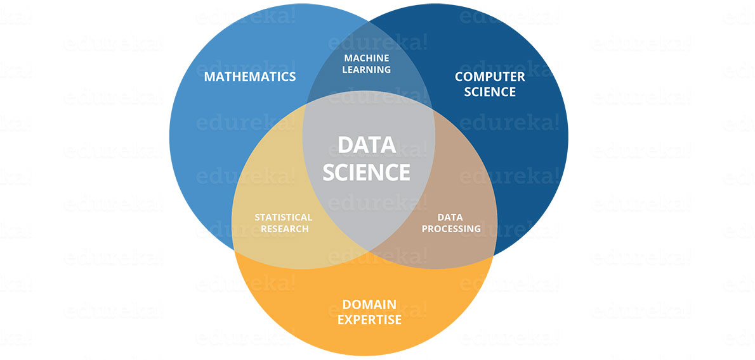
DATA SCIENCE
Summer training In INTERNSHALA
r. Indra narayana

Slide 2

Contents
INTRODUCTION TO DATA SCIENCE
BASIC PYTHON FOR DATA SCIENCE
UNDERSTANDING OF STATISTICS FOR DATA SCIENCE
PREDECTIVE MODELLING
Machine learning algorithms

Slide 3
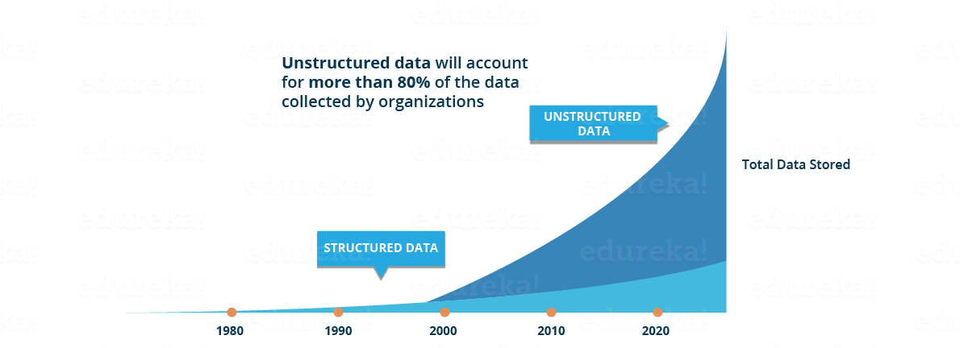
Let’s Understand Why We Need Data Science
Traditionally, the data that we had was mostly structured and small in size, which could be analyzed by using the simple BI tools. Unlike data in the traditional systems which was mostly structured, today most of the data is unstructured or semi-structured. Let’s have a look at the data trends in the image given below which shows that by 2020, more than 80 % of the data will be unstructured.

Slide 4
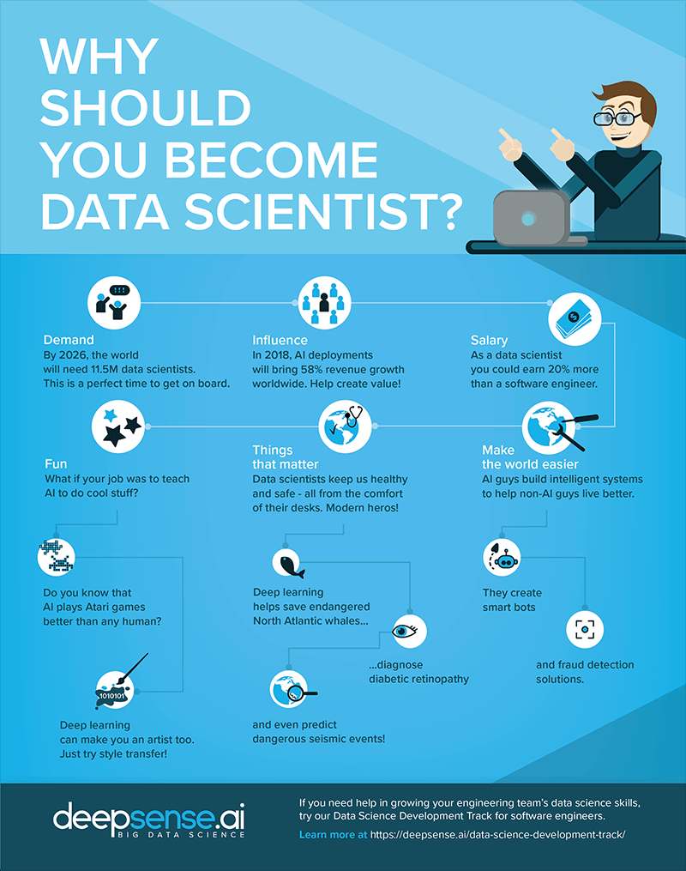
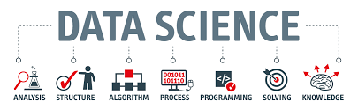
WHAT IS DATA SCIENCE
Industries needs data to help them and make careful decisions and data science churns raw data into meaningful insights. Therefore industries need data science

Slide 5
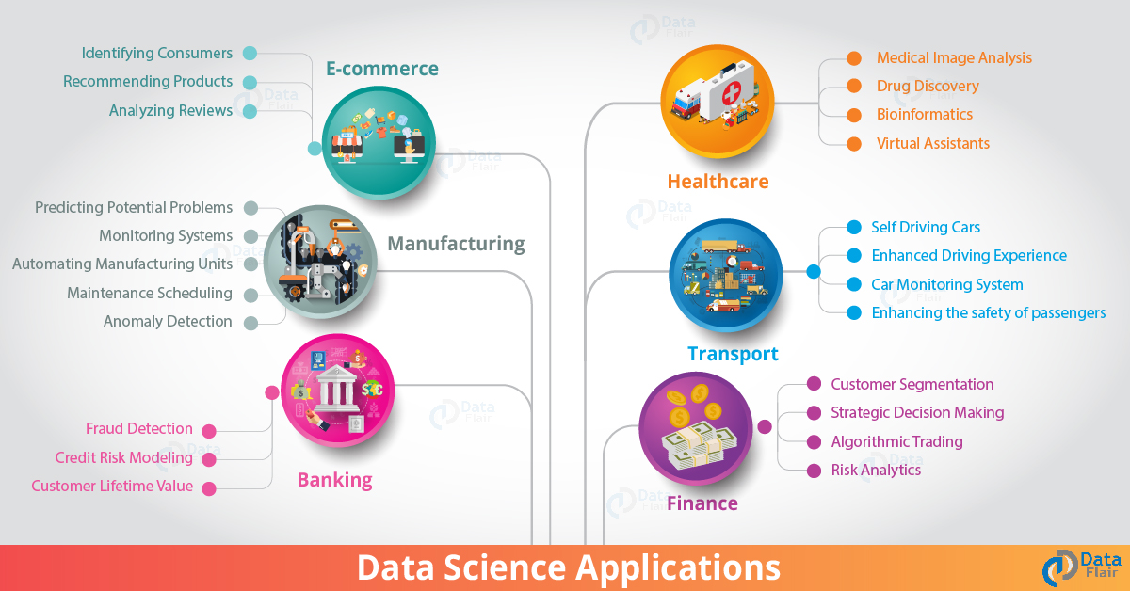

Slide 6
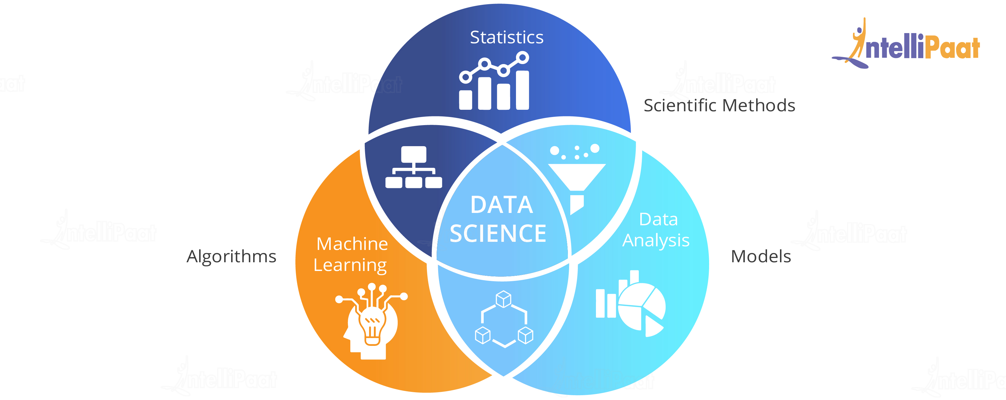
Skills needs for data science
An Analytical Mind
Mathematics
Statistics
Algorithms
Data Visualization
Business Knowledge
Domain Expertise

Slide 7
Data science tools
Excel
Probably the most widely used Data Analysis tool. Microsoft developed Excel mostly for spreadsheet calculations and today, it is widely used for data processing, visualization, and complex calculations. Excel is a powerful analytical tool for Data Science.
Jupyter
Project Jupyter is an open-source tool based on IPython for helping developers in making open-source software and experiences interactive computing. Jupyter supports multiple languages like Julia, Python,. Jupyter is a widely popular tool that is designed to address the requirements of Data Science.
Matplotlib
Natural Language Processing has emerged as the most popular field in Data Science. It deals with the development of statistical models that help computers understand human language.

Slide 8
Basic python for data science
Understanding Operators
Variables and Data Types
Conditional Statements
Looping Constructs
Functions
Lists
Dictionaries
Understanding Standard Libraries in Python
Reading a CSV File in Python 2.12
Data Frames and basic operations with Data Frames
Indexing Data Frame

Slide 9
Python Lists
The list is a most versatile datatype available in Python which can be written as a list of
comma-separated values (items) between square brackets.
Important thing about a list is that items in a list need not be of the same type.
Creating a list is as simple as putting different comma-separated values between square brackets.
For example −
list1 = ['physics', 'chemistry', 1997, 2000];
list2 = [1, 2, 3, 4, 5 ];
list3 = ["a", "b", "c", "d"] ;
Indexing, Slicing, and Matrixes

Slide 10
Dictionaries in python
dict = {'Name': 'Zara', 'Age': 7, 'Class': 'First'}
Each key is separated from its value by a colon (:), the items are separated by commas, and the whole thing is enclosed in curly braces. An empty dictionary without any items is written with just two curly braces, like this: {}.
Keys are unique within a dictionary while values may not be. The values of a dictionary can be of any type, but the keys must be of an immutable data type such as strings, numbers, or tuples.
thisdict = { "brand": "Ford", "model": "Mustang", "year": 1964 } print(thisdict)

Slide 11
UNDERSTANDING OF STATISTICS FOR DATA SCIENCE
Introduction to Statistics
Measures of Central Tendency
Understanding the spread of data
Data Distribution
Introduction to Inferential Statistics
Understanding the Confidence Interval and margin of error
Hypothesis Testing
T tests
Chi Squared Tests
Understanding the concept of Correlation

Slide 12
INTRODUCTION TO DESCRIPTIVE STATICTICS:
Mean: Average of quantities
Mean=data[‘marks’].mean()
Print(mean)
Mode:Most frequently occurring
Mode=data[‘marks’].mode()
Print(mode)
Median: Absolute center value of data set

Slide 13
Variance:Is the average squared deviations from the mean.
Mean= data[‘marks’].mean()
Difference= data[‘marks’]-mean
Squared_difference=difference**2
Variance=squared_difference.mean()
Print(variance)
T-TESTS:An Independent Samples t-test compares the means for two groups. A Paired sample t-test compares means from the same group at different times (say, one year apart). A One sample t-test tests the mean of a single group against a known mean

Slide 14
Hypothesis
What is hypothesis testing ?
Hypothesis testing is a statistical method that is used in making statistical decisions using experimental data. Hypothesis Testing is basically an assumption that we make about the population parameter.
Ex : you say avg student in class is 40 or a boy is taller than girls.
why do we use it ?
Hypothesis testing is an essential procedure in statistics. A hypothesis test evaluates two mutually exclusive statements about a population to determine which statement is best supported by the sample data. When we say that a finding is statistically significant, it’s thanks to a hypothesis test.

Slide 15
Which are important parameter of hypothesis testing
Null hypothesis :- In inferential statistics, the null hypothesis is a general statement or default position that there is no relationship between two measured phenomena, or no association among groups
In other words it is a basic assumption or made based on domain or problem knowledge.
Example : a company production is = 50 unit/per day etc.
Alternative hypothesis :-
The alternative hypothesis is the hypothesis used in hypothesis testing that is contrary to the null hypothesis. It is usually taken to be that the observations are the result of a real effect (with some amount of chance variation superposed)
Example : a company production is !=50 unit/per day etc.

Slide 16
Stages of Predictive Modelling
Problem definition
Hypothesis generation
Data extraction
Data exploration
Predictive modelling
Model implementation

Slide 17
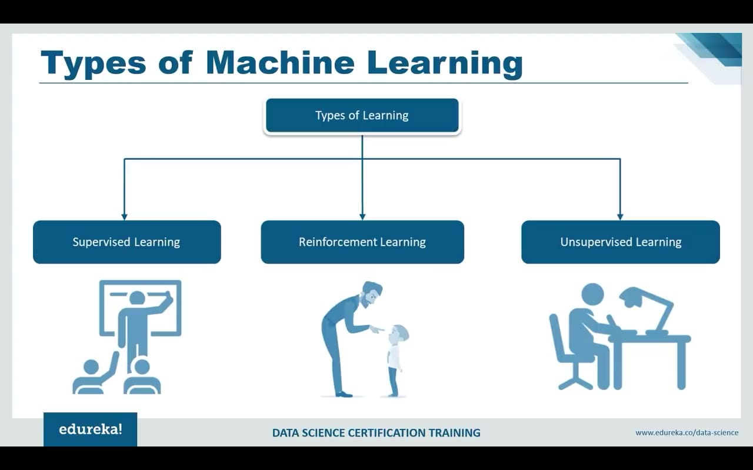
Types Machine Learning
Supervised machine learning
Unsupervised machine learning
Reinforcement machine learning

Slide 18
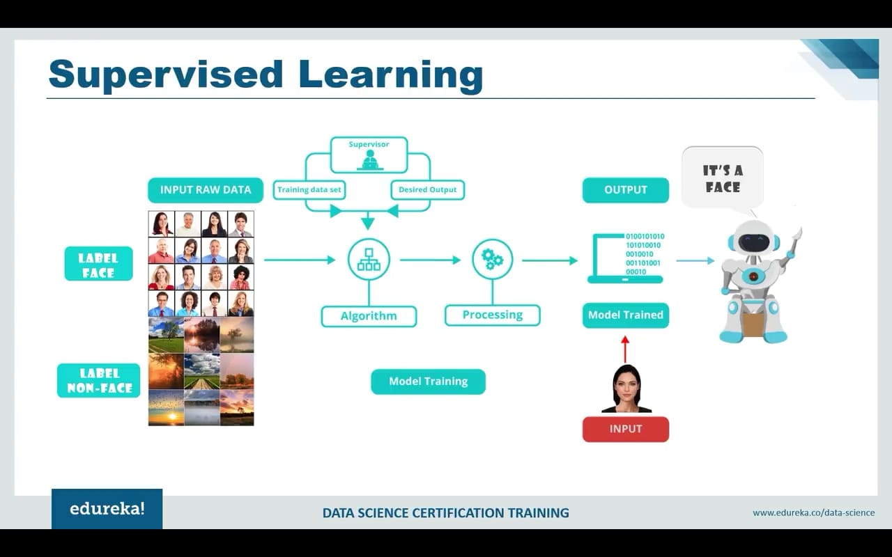
Stages of Predictive Modelling
Problem definition
Hypothesis generation
Data extraction
Data exploration
Predictive modelling
Model implementation

Slide 19
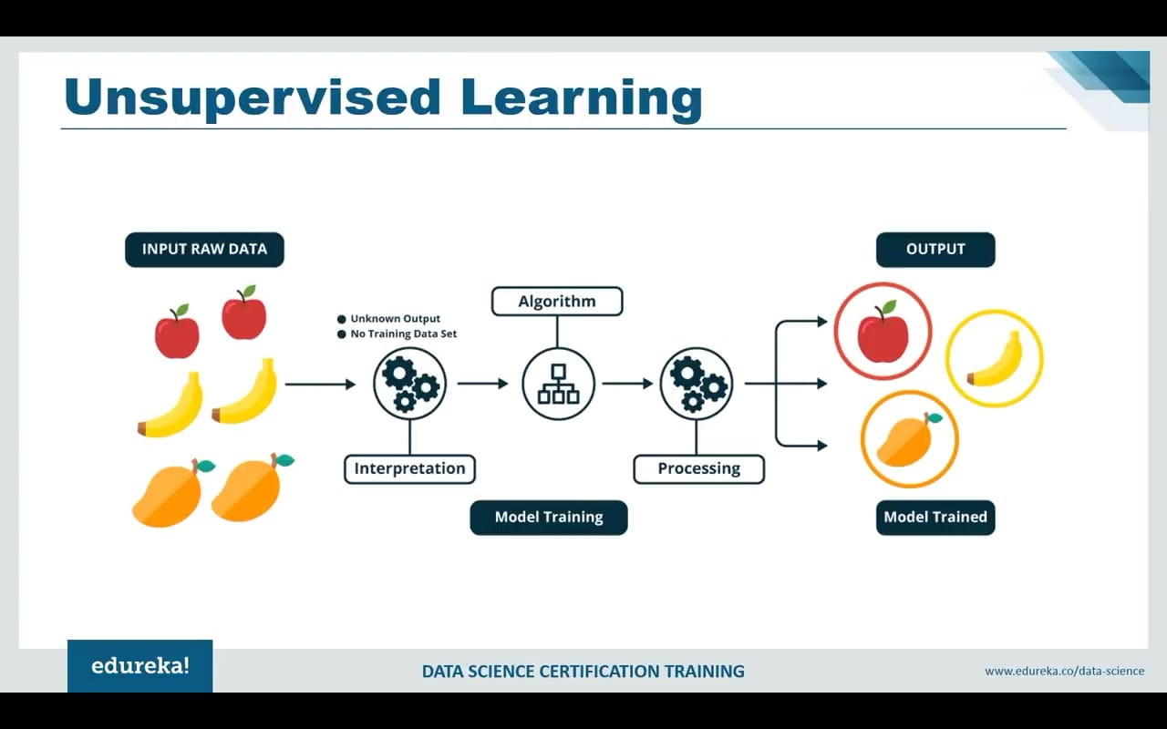
Stages of Predictive Modelling
Problem definition
Hypothesis generation
Data extraction
Data exploration
Predictive modelling
Model implementation

Slide 20
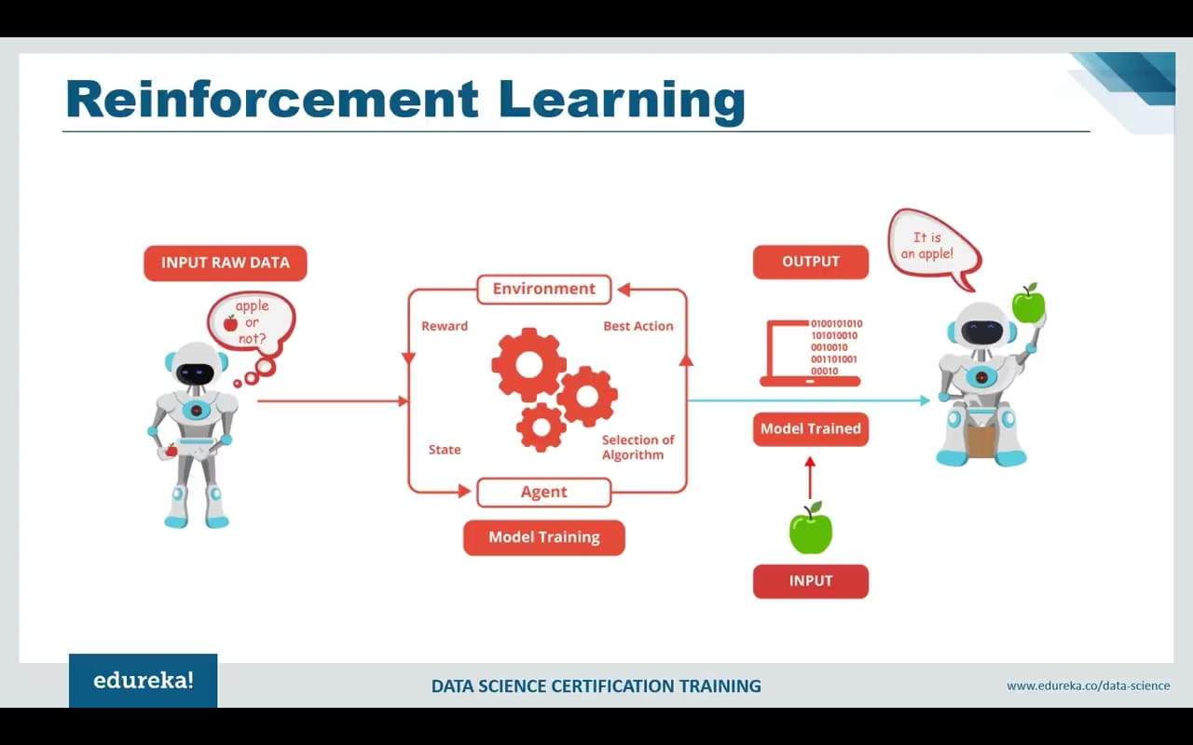
Stages of Predictive Modelling
Problem definition
Hypothesis generation
Data extraction
Data exploration
Predictive modelling
Model implementation

Slide 21
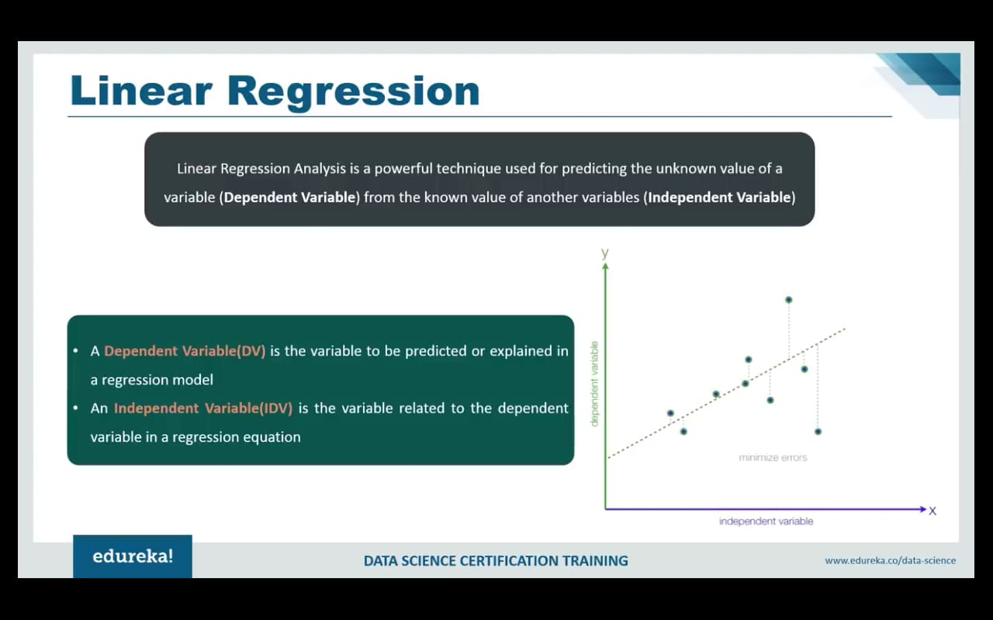
Stages of Predictive Modelling
Problem definition
Hypothesis generation
Data extraction
Data exploration
Predictive modelling
Model implementation

Slide 22
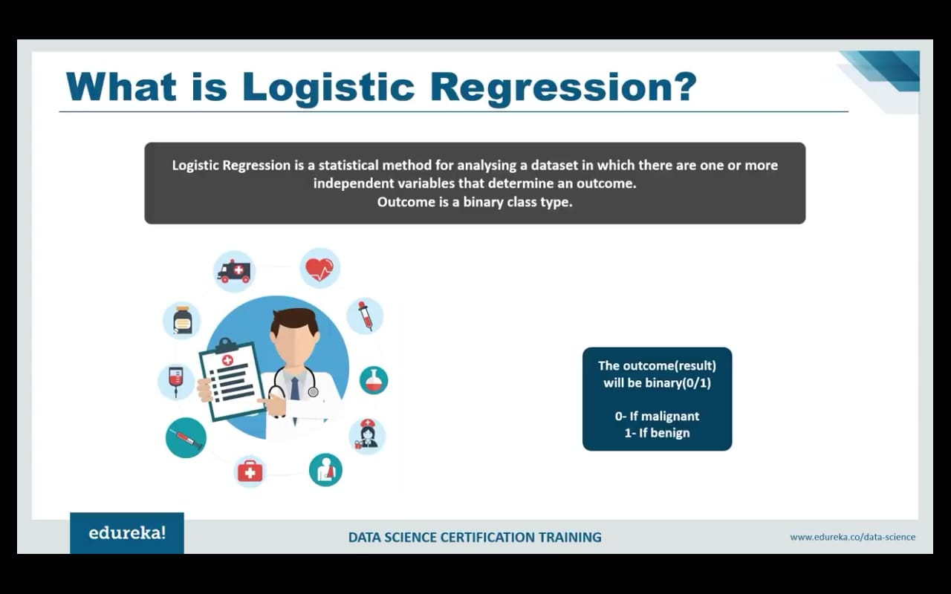
Stages of Predictive Modelling
Problem definition
Hypothesis generation
Data extraction
Data exploration
Predictive modelling
Model implementation

Slide 23
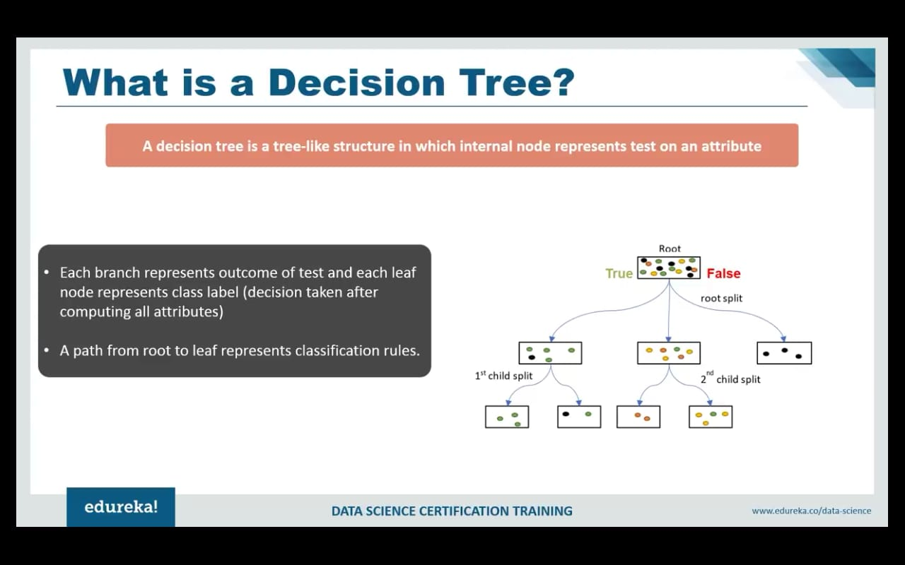
Stages of Predictive Modelling
Problem definition
Hypothesis generation
Data extraction
Data exploration
Predictive modelling
Model implementation

Slide 24
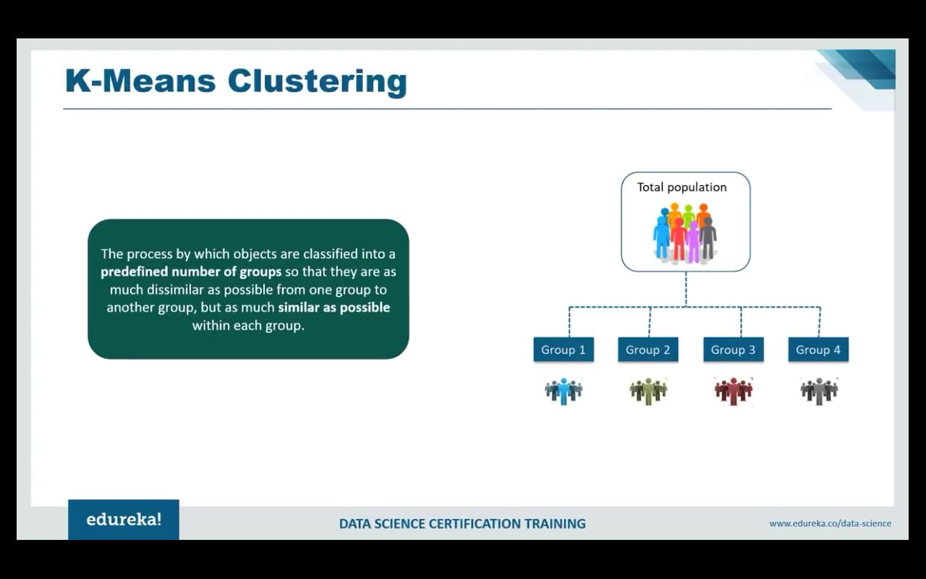
Stages of Predictive Modelling
Problem definition
Hypothesis generation
Data extraction
Data exploration
Predictive modelling
Model implementation

Slide 25
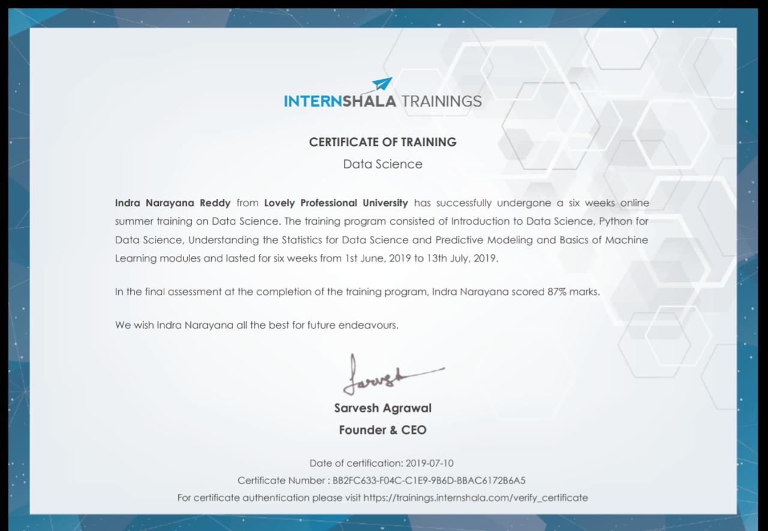
Certificate of completion:

Slide 26
THANK YOU

